Slide 1


forward index(0,0)
barkward index(0,0)
0 | 0 | 0 | 0 | 0
0 | 9 | 6 | 5 | 0
0 | 9 | 7 | 2 | 0
0 | 8 | 6 | 1 | 0
0 | 0 | 0 | 0 | 0
0 | 0 | 0 | 0 | 0
0 | 1 | 0 | 0 | 0
0 | 0 | 0 | 0 | 0
0 | 0 | 0 | 0 | 0
0 | 0 | 0 | 0 | 0
9
$$+1$$
1 | 2 | 4
6 | 2 | 3
7 | 6 | 8
output
back gradient
forward index(0,1)
barkward index(0,1)
0 | 0 | 0 | 0 | 0
0 | 9 | 6 | 5 | 0
0 | 9 | 7 | 2 | 0
0 | 8 | 6 | 1 | 0
0 | 0 | 0 | 0 | 0
0 | 0 | 0 | 0 | 0
0 | 3 | 0 | 0 | 0
0 | 0 | 0 | 0 | 0
0 | 0 | 0 | 0 | 0
0 | 0 | 0 | 0 | 0
9 | 9
$$+2$$
1 | 2 | 4
6 | 2 | 3
7 | 6 | 8
output
back gradient

Slide 2


forward index(0,2)
barkward index(0,2)
0 | 0 | 0 | 0 | 0
0 | 9 | 6 | 5 | 0
0 | 9 | 7 | 2 | 0
0 | 8 | 6 | 1 | 0
0 | 0 | 0 | 0 | 0
0 | 0 | 0 | 0 | 0
0 | 3 | 0 | 0 | 0
0 | 0 | 4 | 0 | 0
0 | 0 | 0 | 0 | 0
0 | 0 | 0 | 0 | 0
9 | 9 | 7
$$+4$$
1 | 2 | 4
6 | 2 | 3
7 | 6 | 8
output
back gradient
forward index(1,0)
barkward index(1,0)
0 | 0 | 0 | 0 | 0
0 | 9 | 6 | 5 | 0
0 | 9 | 7 | 2 | 0
0 | 8 | 6 | 1 | 0
0 | 0 | 0 | 0 | 0
0 | 0 | 0 | 0 | 0
0 | 9 | 0 | 0 | 0
0 | 0 | 4 | 0 | 0
0 | 0 | 0 | 0 | 0
0 | 0 | 0 | 0 | 0
9 | 9 | 7
9
$$+6$$
1 | 2 | 4
6 | 2 | 3
7 | 6 | 8
output
back gradient

Slide 3
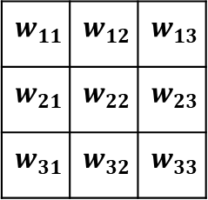
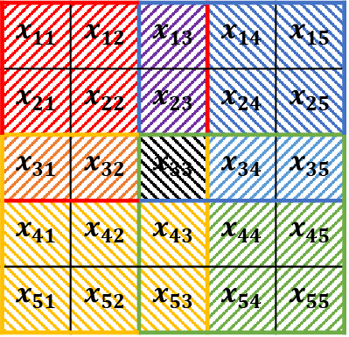

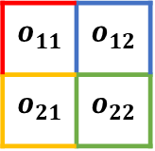
kernel size 3x3 / stride 2x2
$$x_{11}$$ | $$x_{12}$$ | $$x_{13}$$ | $$x_{14}$$ | $$x_{15}$$
$$x_{21}$$ | $$x_{22}$$ | $$x_{23}$$ | $$x_{24}$$ | $$x_{25}$$
$$x_{31}$$ | $$x_{32}$$ | $$x_{33}$$ | $$x_{34}$$ | $$x_{35}$$
$$x_{41}$$ | $$x_{42}$$ | $$x_{43}$$ | $$x_{44}$$ | $$x_{45}$$
$$x_{51}$$ | $$x_{52}$$ | $$x_{53}$$ | $$x_{54}$$ | $$x_{55}$$
$$w_{11}$$ | $$w_{12}$$ | $$w_{13}$$
$$w_{21}$$ | $$w_{22}$$ | $$w_{23}$$
$$w_{31}$$ | $$w_{32}$$ | $$w_{33}$$
$$o_{11}$$ | $$o_{12}$$
$$o_{21}$$ | $$o_{22}$$
*
+
$$b$$
b

Slide 4
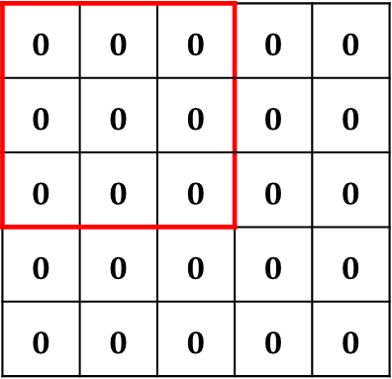
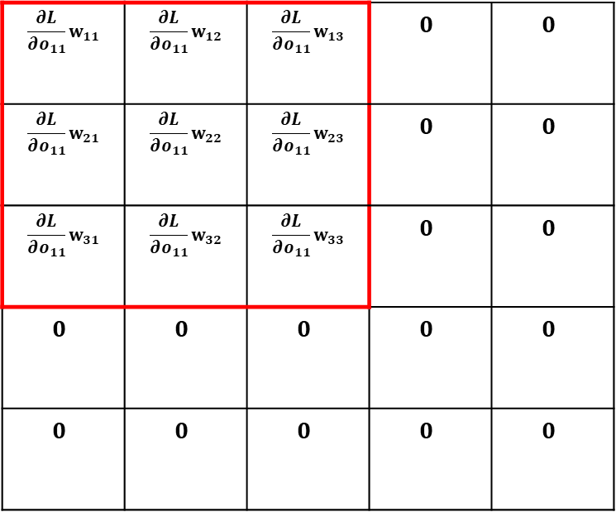
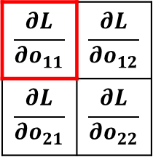
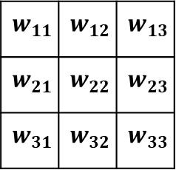
$$w_{11}$$ | $$w_{12}$$ | $$w_{13}$$
$$w_{21}$$ | $$w_{22}$$ | $$w_{23}$$
$$w_{31}$$ | $$w_{32}$$ | $$w_{33}$$
$$\frac{∂L}{∂o_{11}}w_{11}$$ | $$\frac{∂L}{∂o_{11}}w_{12}$$ | $$\frac{∂L}{∂o_{11}}w_{13}$$ | $$0$$ | $$0$$
$$\frac{∂L}{∂o_{11}}w_{21}$$ | $$\frac{∂L}{∂o_{11}}w_{22}$$ | $$\frac{∂L}{∂o_{11}}w_{23}$$ | $$0$$ | $$0$$
$$\frac{∂L}{∂o_{11}}w_{31}$$ | $$\frac{∂L}{∂o_{11}}w_{32}$$ | $$\frac{∂L}{∂o_{11}}w_{33}$$ | $$0$$ | $$0$$
$$0$$ | $$0$$ | $$0$$ | $$0$$ | $$0$$
$$0$$ | $$0$$ | $$0$$ | $$0$$ | $$0$$
$$0$$ | $$0$$ | $$0$$ | $$0$$ | $$0$$
$$0$$ | $$0$$ | $$0$$ | $$0$$ | $$0$$
$$0$$ | $$0$$ | $$0$$ | $$0$$ | $$0$$
$$0$$ | $$0$$ | $$0$$ | $$0$$ | $$0$$
$$0$$ | $$0$$ | $$0$$ | $$0$$ | $$0$$
$$\frac{∂L}{∂o_{11}}$$ | $$\frac{∂L}{∂o_{12}}$$
$$\frac{∂L}{∂o_{21}}$$ | $$\frac{∂L}{∂o_{22}}$$

Slide 5
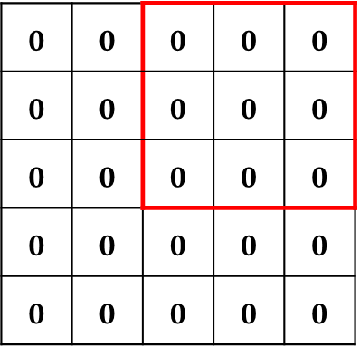
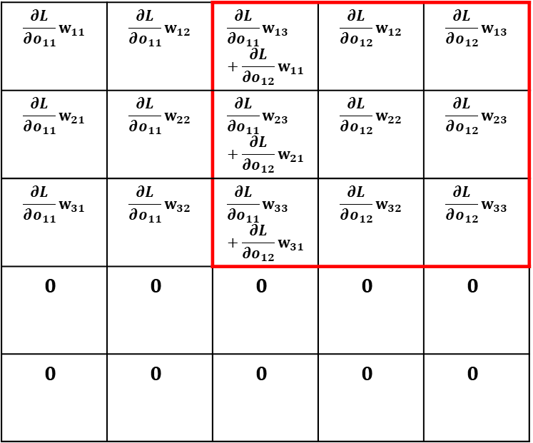
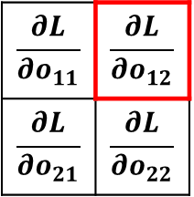
$$\frac{∂L}{∂o_{11}}w_{11}$$ | $$\frac{∂L}{∂o_{11}}w_{12}$$ | $$\frac{∂L}{∂o_{11}}w_{13}+\frac{∂L}{∂o_{12}}w_{11}$$ | $$\frac{∂L}{∂o_{12}}w_{12}$$ | $$\frac{∂L}{∂o_{12}}w_{13}$$
$$\frac{∂L}{∂o_{11}}w_{21}$$ | $$\frac{∂L}{∂o_{11}}w_{22}$$ | $$\frac{∂L}{∂o_{11}}w_{23}+\frac{∂L}{∂o_{12}}w_{21}$$ | $$\frac{∂L}{∂o_{12}}w_{22}$$ | $$\frac{∂L}{∂o_{12}}w_{23}$$
$$\frac{∂L}{∂o_{11}}w_{31}$$ | $$\frac{∂L}{∂o_{11}}w_{32}$$ | $$\frac{∂L}{∂o_{11}}w_{33}+\frac{∂L}{∂o_{12}}w_{31}$$ | $$\frac{∂L}{∂o_{12}}w_{32}$$ | $$\frac{∂L}{∂o_{12}}w_{33}$$
$$0$$ | $$0$$ | $$0$$ | $$0$$ | $$0$$
$$0$$ | $$0$$ | $$0$$ | $$0$$ | $$0$$
$$w_{11}$$ | $$w_{12}$$ | $$w_{13}$$
$$w_{21}$$ | $$w_{22}$$ | $$w_{23}$$
$$w_{31}$$ | $$w_{32}$$ | $$w_{33}$$
$$0$$ | $$0$$ | $$0$$ | $$0$$ | $$0$$
$$0$$ | $$0$$ | $$0$$ | $$0$$ | $$0$$
$$0$$ | $$0$$ | $$0$$ | $$0$$ | $$0$$
$$0$$ | $$0$$ | $$0$$ | $$0$$ | $$0$$
$$0$$ | $$0$$ | $$0$$ | $$0$$ | $$0$$
$$\frac{∂L}{∂o_{11}}$$ | $$\frac{∂L}{∂o_{12}}$$
$$\frac{∂L}{∂o_{21}}$$ | $$\frac{∂L}{∂o_{22}}$$

Slide 6
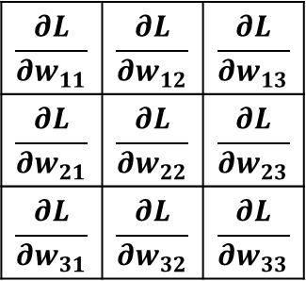
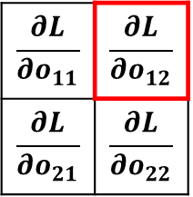
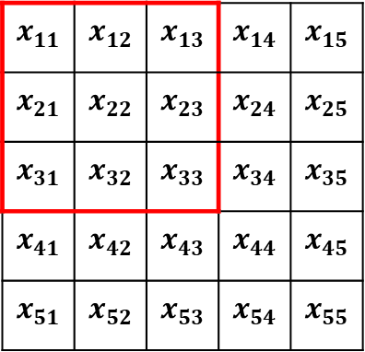
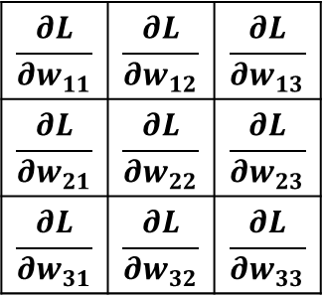
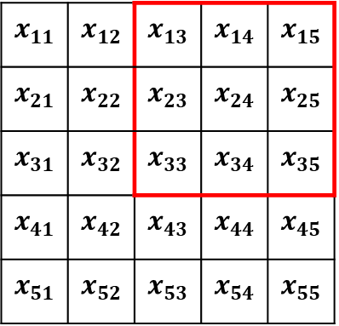
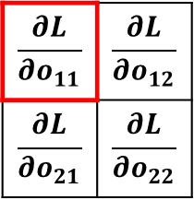
$$x_{11}$$ | $$x_{12}$$ | $$x_{13}$$ | $$x_{14}$$ | $$x_{15}$$
$$x_{21}$$ | $$x_{22}$$ | $$x_{23}$$ | $$x_{24}$$ | $$x_{25}$$
$$x_{31}$$ | $$x_{32}$$ | $$x_{33}$$ | $$x_{34}$$ | $$x_{35}$$
$$x_{41}$$ | $$x_{42}$$ | $$x_{43}$$ | $$x_{44}$$ | $$x_{45}$$
$$x_{51}$$ | $$x_{52}$$ | $$x_{53}$$ | $$x_{54}$$ | $$x_{55}$$
$$\frac{∂L}{∂w_{11}}$$ | $$\frac{∂L}{∂w_{12}}$$ | $$\frac{∂L}{∂w_{13}}$$
$$\frac{∂L}{∂w_{21}}$$ | $$\frac{∂L}{∂w_{22}}$$ | $$\frac{∂L}{∂w_{23}}$$
$$\frac{∂L}{∂w_{31}}$$ | $$\frac{∂L}{∂w_{32}}$$ | $$\frac{∂L}{∂w_{33}}$$
$$\frac{∂L}{∂o_{11}}$$ | $$\frac{∂L}{∂o_{12}}$$
$$\frac{∂L}{∂o_{21}}$$ | $$\frac{∂L}{∂o_{22}}$$
$$x_{11}$$ | $$x_{12}$$ | $$x_{13}$$ | $$x_{14}$$ | $$x_{15}$$
$$x_{21}$$ | $$x_{22}$$ | $$x_{23}$$ | $$x_{24}$$ | $$x_{25}$$
$$x_{31}$$ | $$x_{32}$$ | $$x_{33}$$ | $$x_{34}$$ | $$x_{35}$$
$$x_{41}$$ | $$x_{42}$$ | $$x_{43}$$ | $$x_{44}$$ | $$x_{45}$$
$$x_{51}$$ | $$x_{52}$$ | $$x_{53}$$ | $$x_{54}$$ | $$x_{55}$$
$$\frac{∂L}{∂w_{11}}$$ | $$\frac{∂L}{∂w_{12}}$$ | $$\frac{∂L}{∂w_{13}}$$
$$\frac{∂L}{∂w_{21}}$$ | $$\frac{∂L}{∂w_{22}}$$ | $$\frac{∂L}{∂w_{23}}$$
$$\frac{∂L}{∂w_{31}}$$ | $$\frac{∂L}{∂w_{32}}$$ | $$\frac{∂L}{∂w_{33}}$$
$$\frac{∂L}{∂o_{11}}$$ | $$\frac{∂L}{∂o_{12}}$$
$$\frac{∂L}{∂o_{21}}$$ | $$\frac{∂L}{∂o_{22}}$$

Slide 7
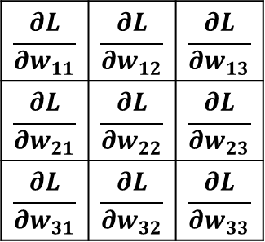
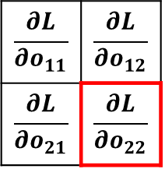
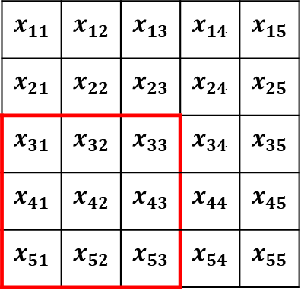
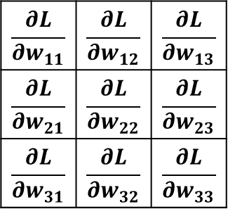
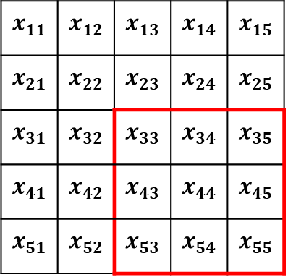
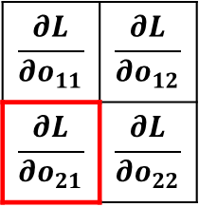
$$x_{11}$$ | $$x_{12}$$ | $$x_{13}$$ | $$x_{14}$$ | $$x_{15}$$
$$x_{21}$$ | $$x_{22}$$ | $$x_{23}$$ | $$x_{24}$$ | $$x_{25}$$
$$x_{31}$$ | $$x_{32}$$ | $$x_{33}$$ | $$x_{34}$$ | $$x_{35}$$
$$x_{41}$$ | $$x_{42}$$ | $$x_{43}$$ | $$x_{44}$$ | $$x_{45}$$
$$x_{51}$$ | $$x_{52}$$ | $$x_{53}$$ | $$x_{54}$$ | $$x_{55}$$
$$\frac{∂L}{∂w_{11}}$$ | $$\frac{∂L}{∂w_{12}}$$ | $$\frac{∂L}{∂w_{13}}$$
$$\frac{∂L}{∂w_{21}}$$ | $$\frac{∂L}{∂w_{22}}$$ | $$\frac{∂L}{∂w_{23}}$$
$$\frac{∂L}{∂w_{31}}$$ | $$\frac{∂L}{∂w_{32}}$$ | $$\frac{∂L}{∂w_{33}}$$
$$\frac{∂L}{∂o_{11}}$$ | $$\frac{∂L}{∂o_{12}}$$
$$\frac{∂L}{∂o_{21}}$$ | $$\frac{∂L}{∂o_{22}}$$
$$x_{11}$$ | $$x_{12}$$ | $$x_{13}$$ | $$x_{14}$$ | $$x_{15}$$
$$x_{21}$$ | $$x_{22}$$ | $$x_{23}$$ | $$x_{24}$$ | $$x_{25}$$
$$x_{31}$$ | $$x_{32}$$ | $$x_{33}$$ | $$x_{34}$$ | $$x_{35}$$
$$x_{41}$$ | $$x_{42}$$ | $$x_{43}$$ | $$x_{44}$$ | $$x_{45}$$
$$x_{51}$$ | $$x_{52}$$ | $$x_{53}$$ | $$x_{54}$$ | $$x_{55}$$
$$\frac{∂L}{∂w_{11}}$$ | $$\frac{∂L}{∂w_{12}}$$ | $$\frac{∂L}{∂w_{13}}$$
$$\frac{∂L}{∂w_{21}}$$ | $$\frac{∂L}{∂w_{22}}$$ | $$\frac{∂L}{∂w_{23}}$$
$$\frac{∂L}{∂w_{31}}$$ | $$\frac{∂L}{∂w_{32}}$$ | $$\frac{∂L}{∂w_{33}}$$
$$\frac{∂L}{∂o_{11}}$$ | $$\frac{∂L}{∂o_{12}}$$
$$\frac{∂L}{∂o_{21}}$$ | $$\frac{∂L}{∂o_{22}}$$

